Slide 1





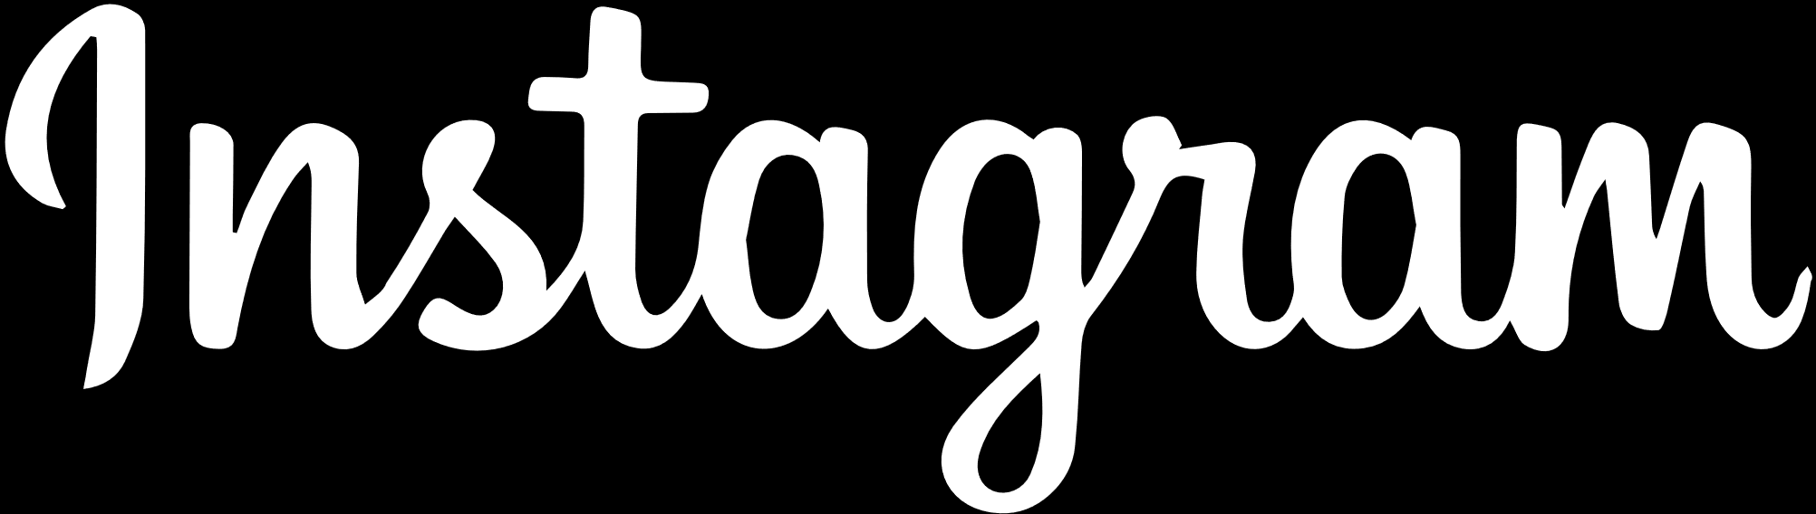


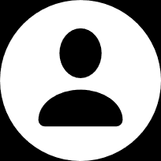










User analytics

Slide 2


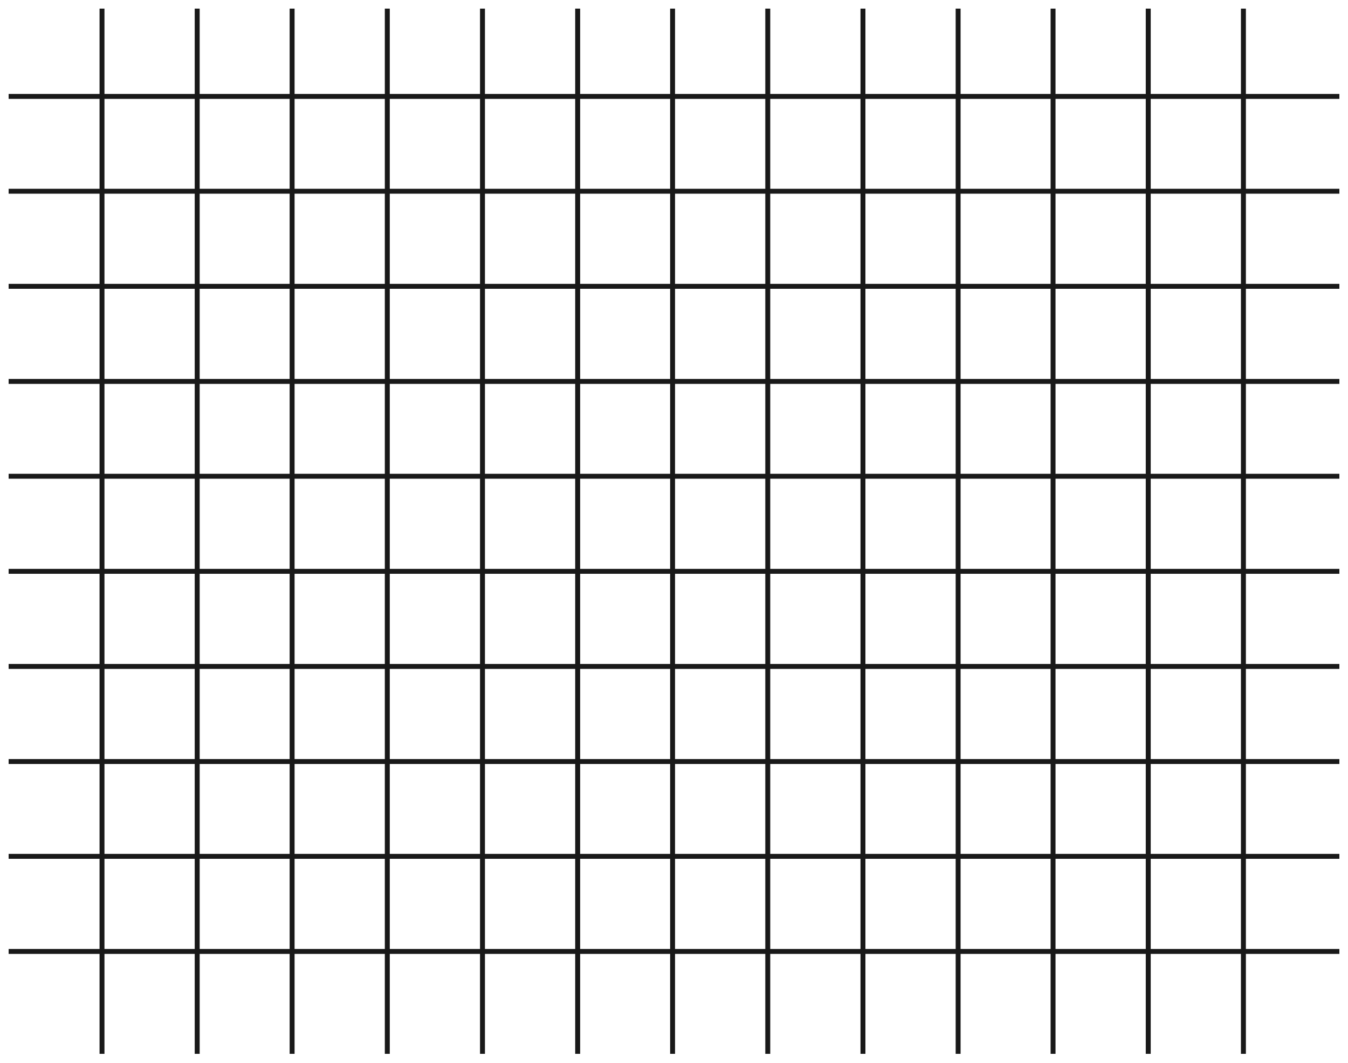



Introduction
Contents
Analysis- Marketing Dept.
Analysis- Investor Metrics Dept.
Summary

Slide 3

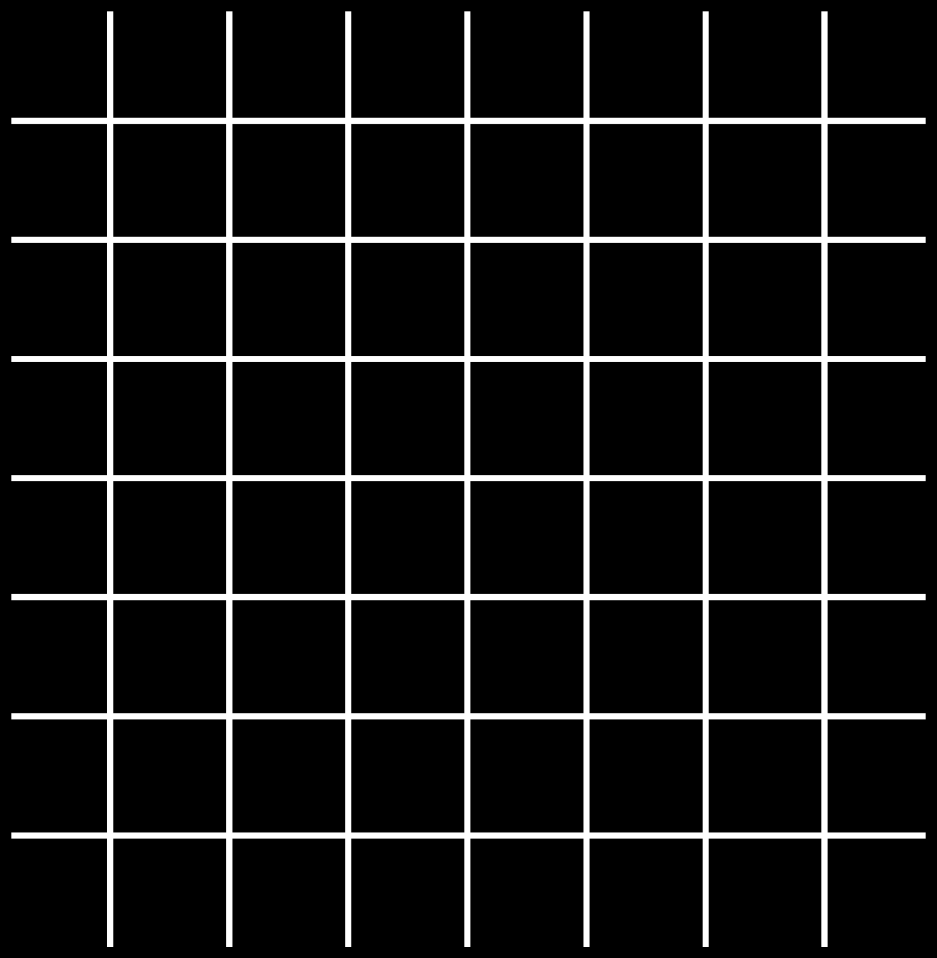
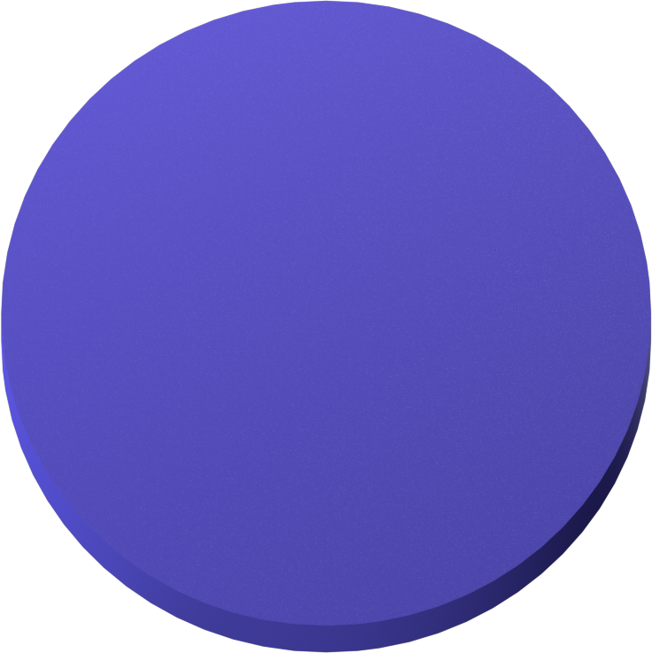
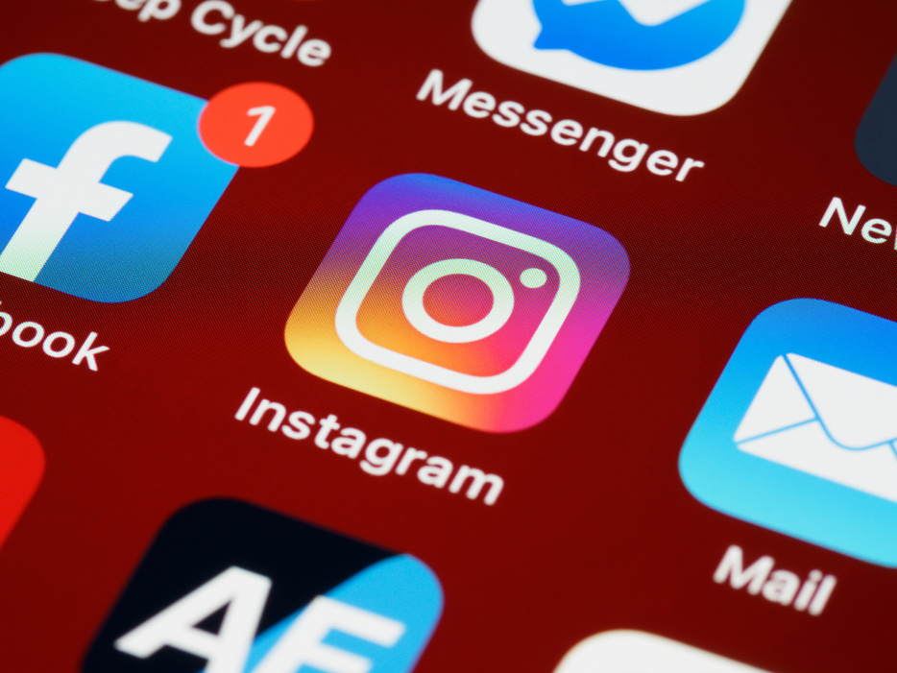

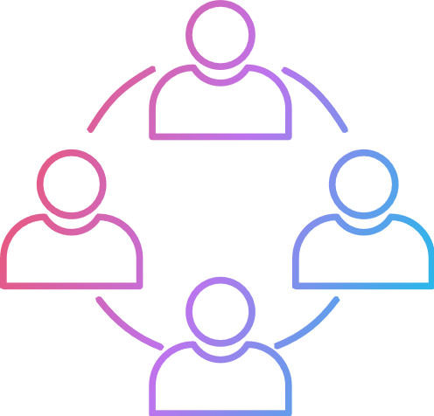
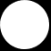
Introduction
In this project, we are supposed to provide a detailed report for the Marketing and Investor metrics department. this analysis will help them make a decision based on different metrics and insights.
Marketing Investor metrics

Slide 4




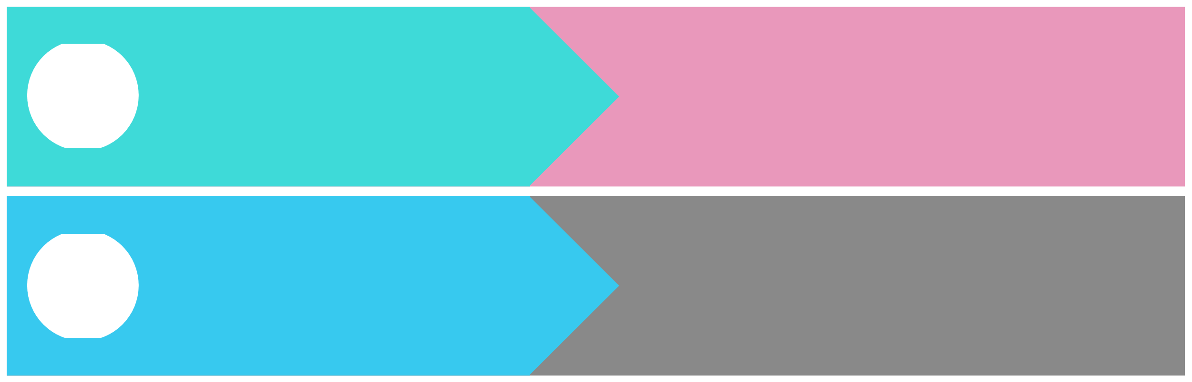



Find the 5 oldest users of the Instagram from the database provided
01
REWARDING MOST LOYAL USERS
REMIND INACTIVE USERS TO START POSTING
Find the users who have never posted a single photo on Instagram
02
DECLARING CONTEST WINNER
Identify the winner of the
contest and provide their details to the team
03
HASHTAG RESEARCHING
Identify and suggest the top 5 most commonly used hashtags on the platform
04
What day of the week do most users register on? Provide insights on when to schedule an ad campaign
LAUNCH AD CAMPAIGN
05

Slide 5

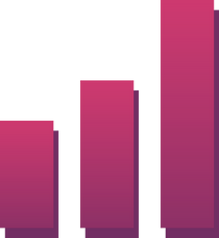





Investor Metrics:
User Engagement:
2. Bots & Fake Accounts:
Provide how many times does average user posts on Instagram. Also, provide the total number of photos on
Instagram/total number of users
Provide data on users (bots) who have liked every single photo on the site (since any normal user would not be able to do this).

Slide 6

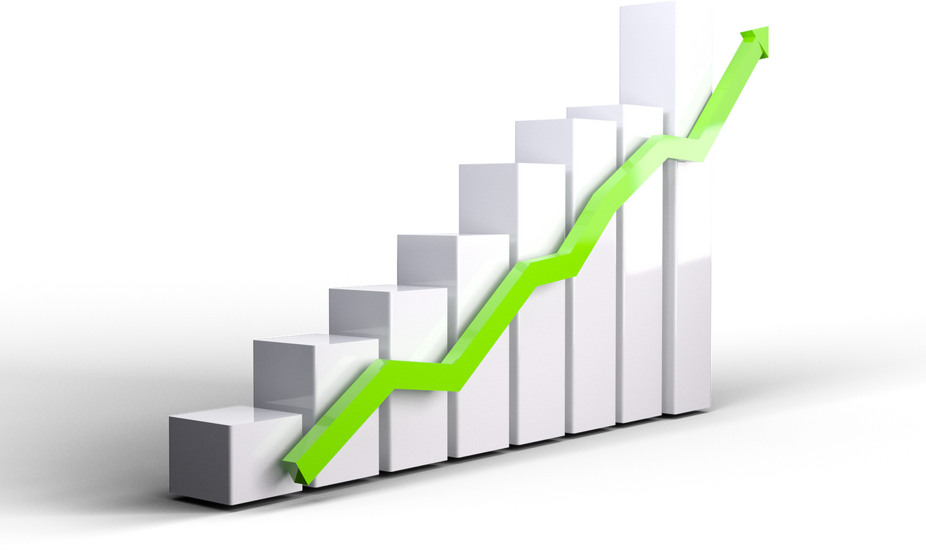


Rewarding the most loyal users
TOP 5 OLDEST USERS
01
02
03
04
05
Darby_Herzog
2016-0 5-06
Emilio_Bernier52
2016-0 5-06
Elenor88
2016-0 5-08
Nicole71
2016-0 5-09
Jordyn.Jacobson2
2016-0 5-14

Slide 7

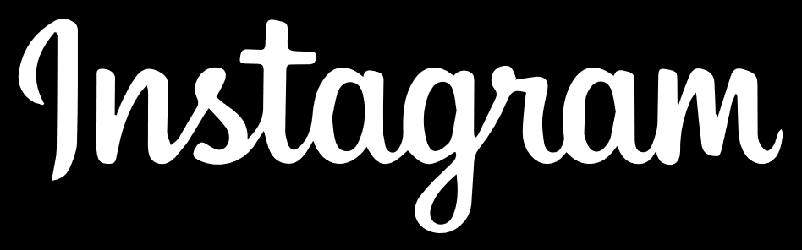

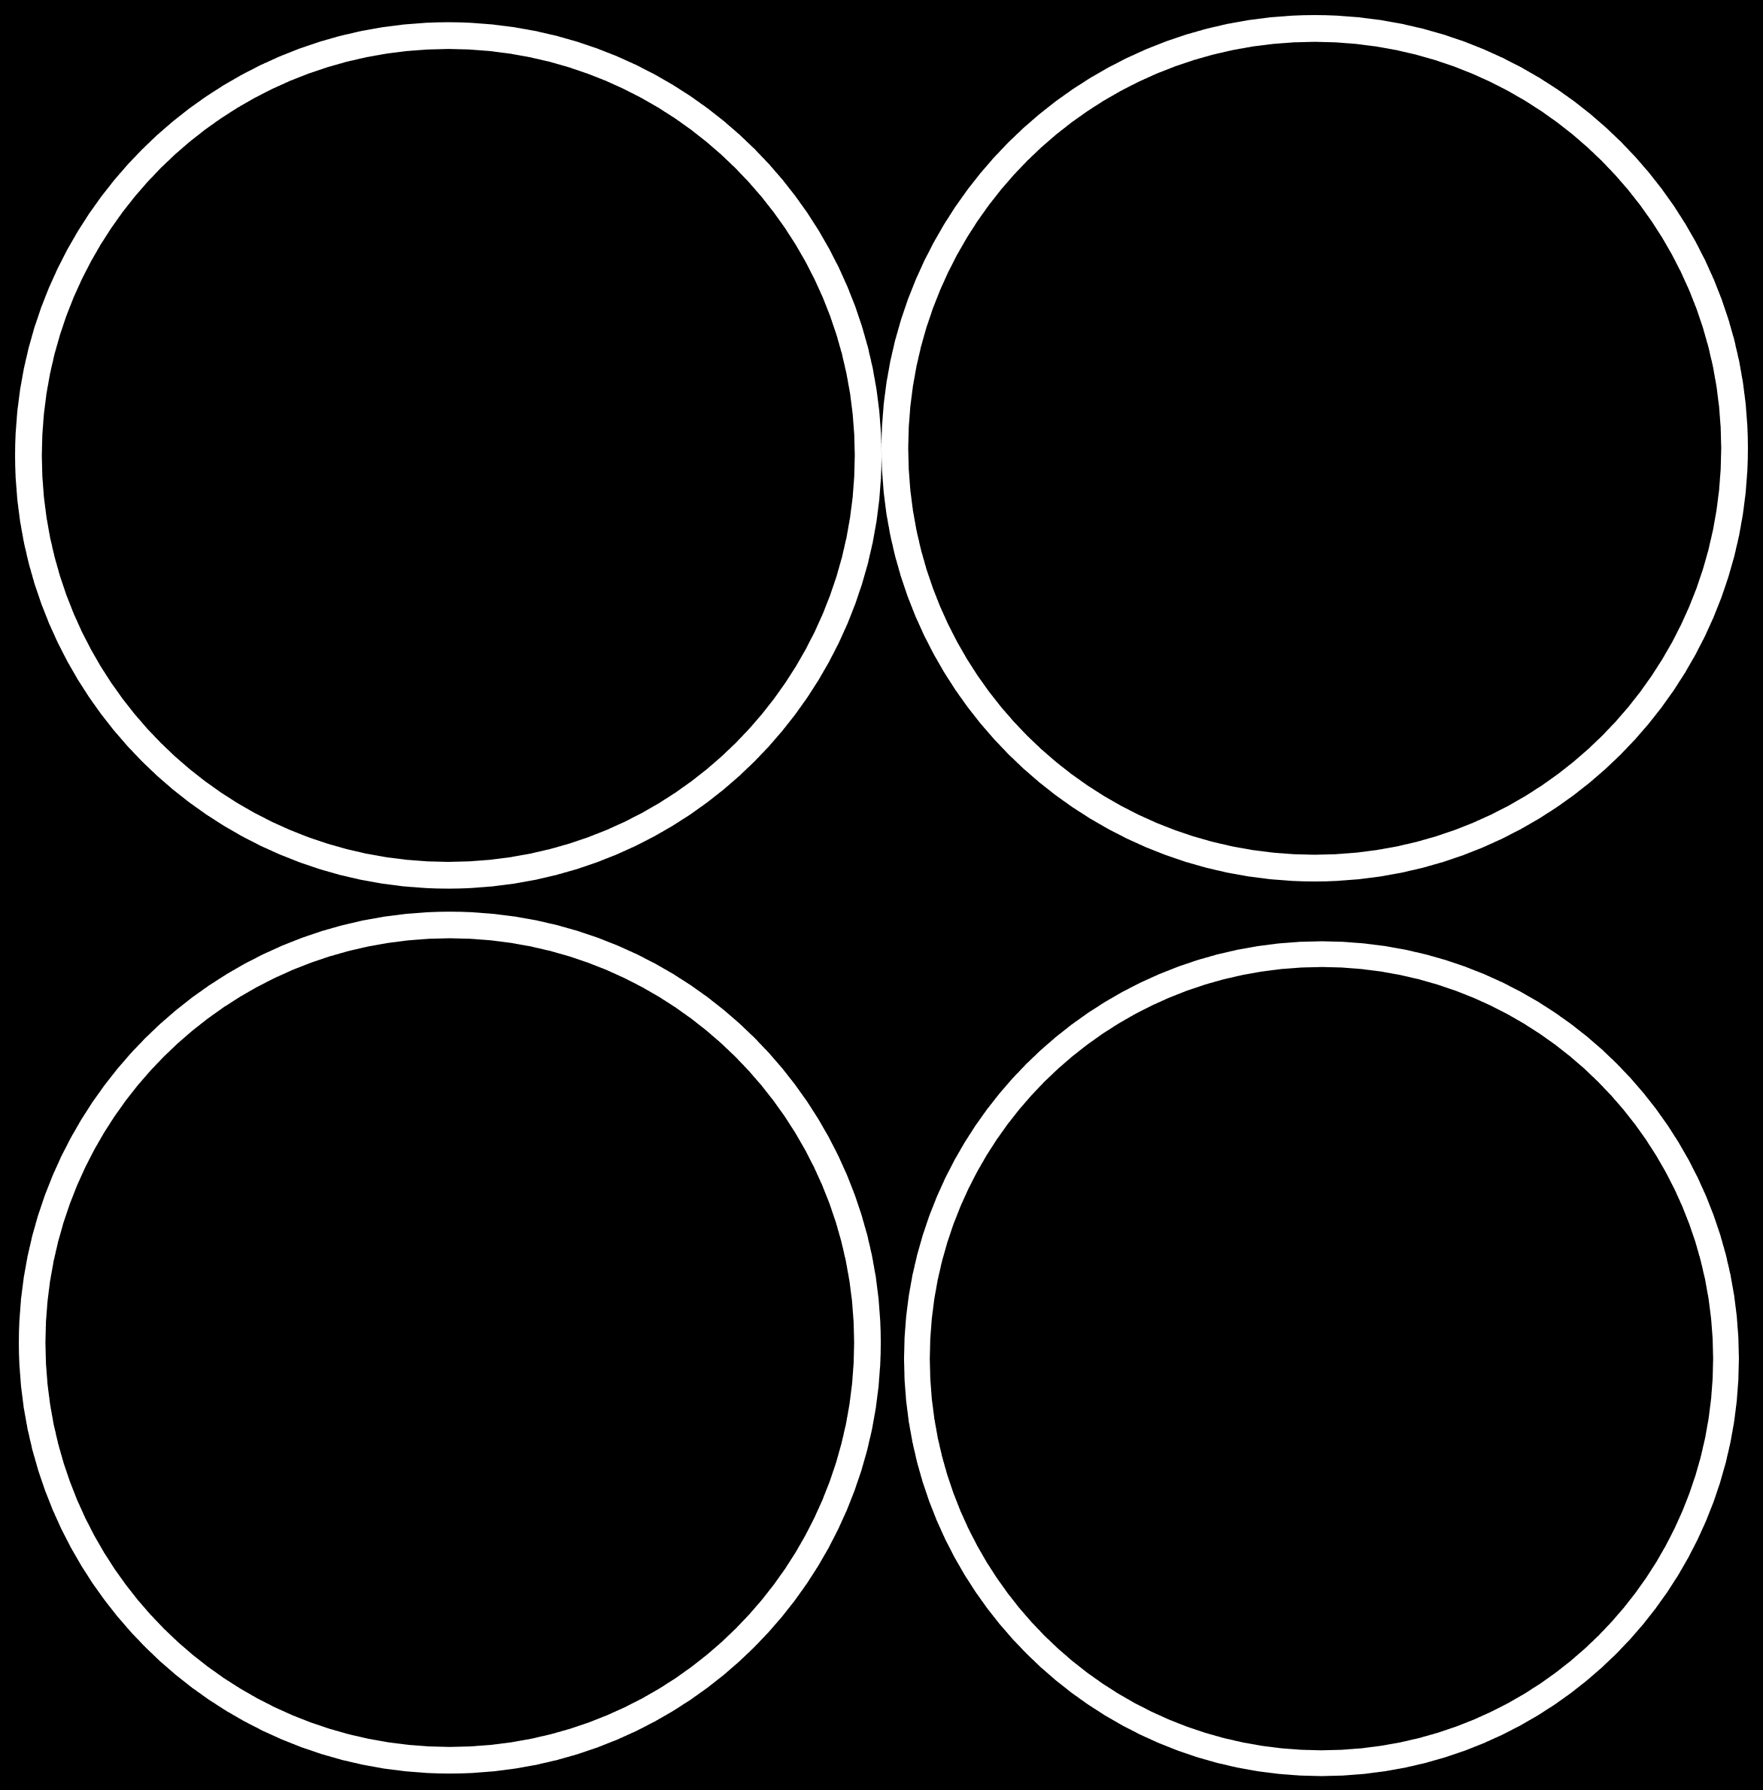
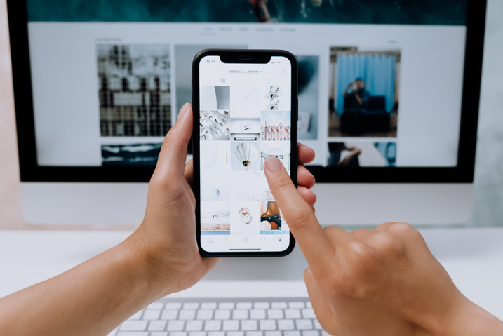
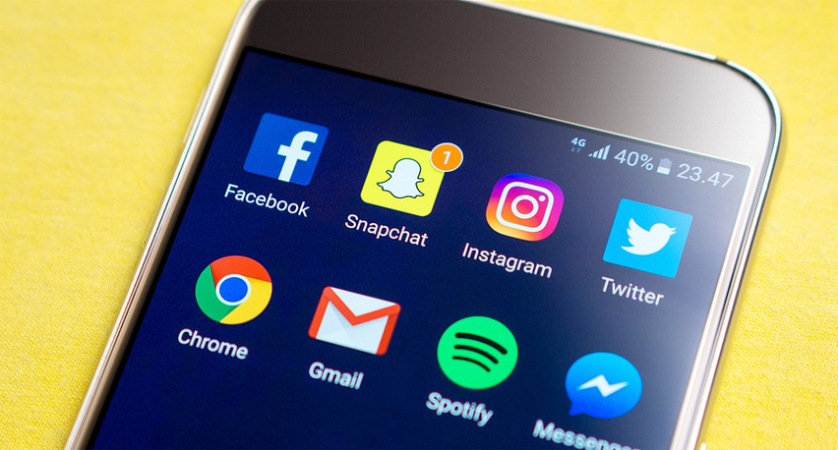



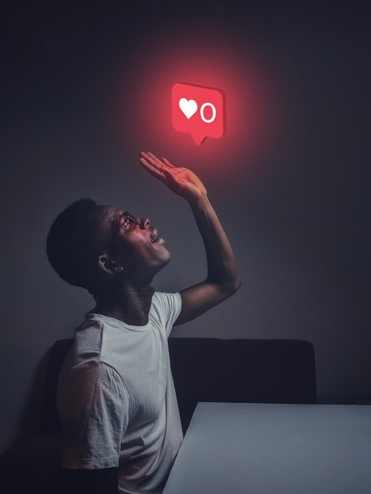


Remind Inactive users to start posting
We have found a list of 26 people with their user id who have never posted a single photo on Instagram. they'll be receiving promotional emails to post their 1st photo.
5-Aniya_Hackett 7-Kasandra_Homenick 14-Jaclyn81 21-Rocio33 24-Maxwell.Halvorson 25-Tierra.Trantow 34-Pearl7 36-Ollie_Ledner37 41-Mckenna17 45-David.Osinski47
49-Morgan.Kassulke 53-Linnea59 54-Duane60 57-Julien_Schmidt 66-Mike.Auer39 68-Franco_Keebler64 71-Nia_Haag 74-Hulda.Macejkovic 75-Leslie67 76-Janelle.Nikolaus81
80-Darby_Herzog 81-Esther.Zulauf61 83-Bartholome.Bernhard 89-Jessyca_West 90-Esmeralda.Mraz57 91-Bethany20
REMINDER

Slide 8
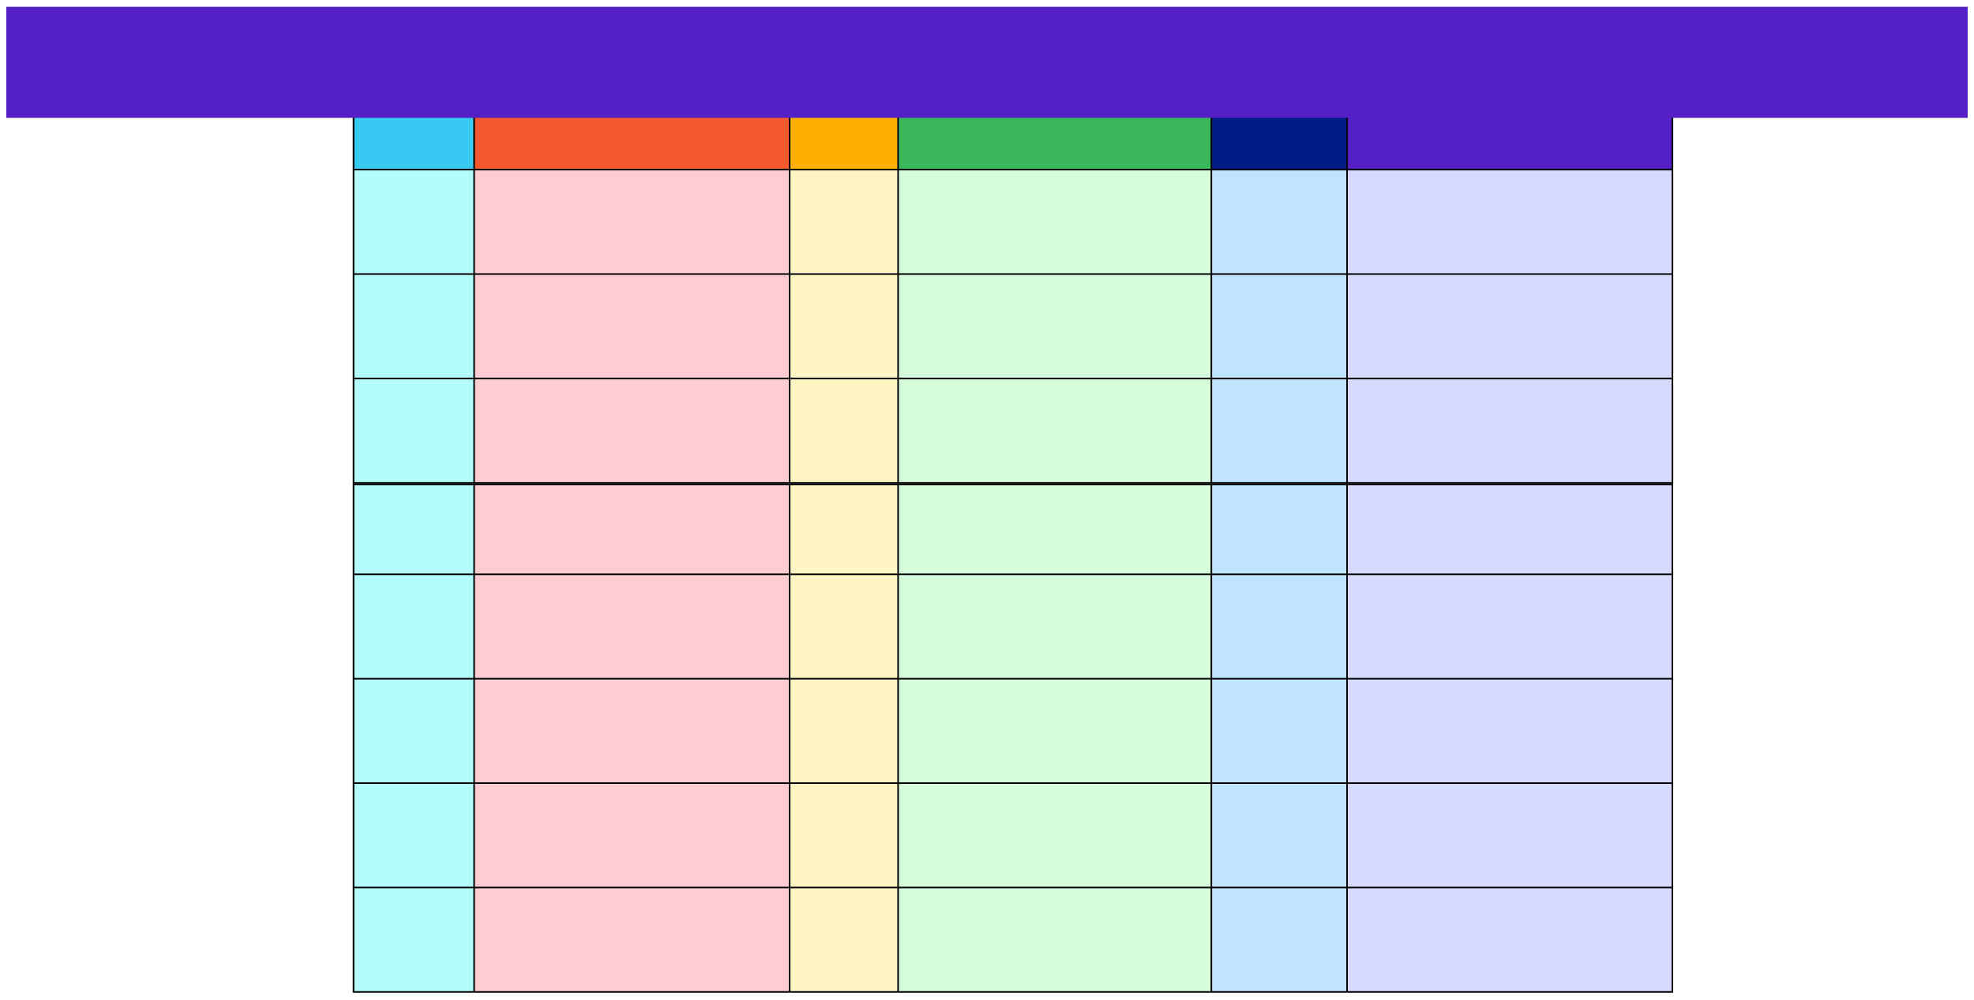

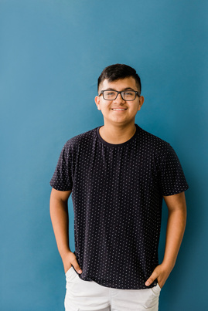
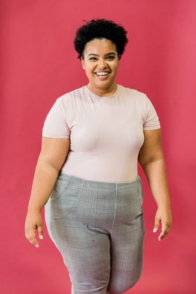
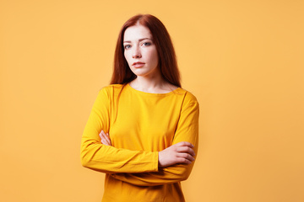


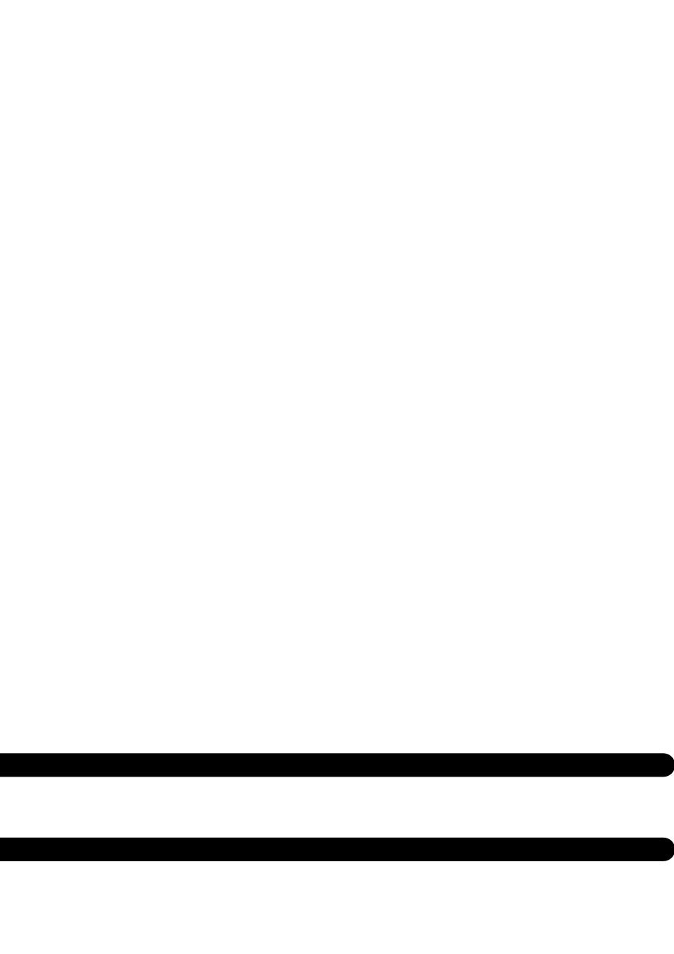
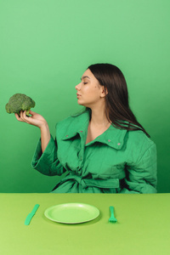
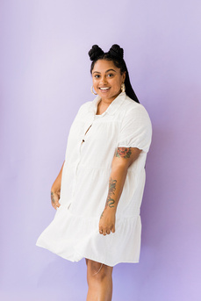
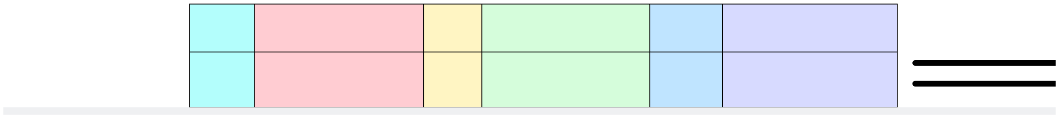
Tabular representation
ID
Username
ID
Username
ID
Username
5
Aniya_Hackett
45
David.Osinski47
75
Leslie67
7
Kasandra_Homenick
49
Morgan.Kassulke
76
Janelle.Nikolaus81
14
Jaclyn81
53
Linnea59
80
Darby_Herzog
21
Rocio33
54
Duane60
81
Esther.Zulauf61
24
Maxwell.Halvorson
57
Julien_Schmidt
83
Bartholome.Bernhard
25
Tierra.Trantow
66
Mike.Auer39
89
Jessyca_West
34
Pearl7
68
Franco_Keebler64
90
Esmeralda.Mraz57
36
Ollie_Ledner37
71
Nia_Haag
91
Bethany20
41
Mckenna17
74
Hulda.Macejkovic

Slide 9
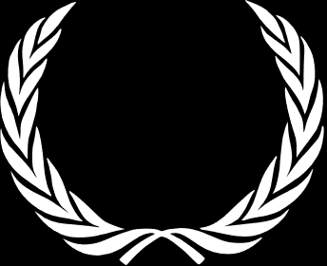
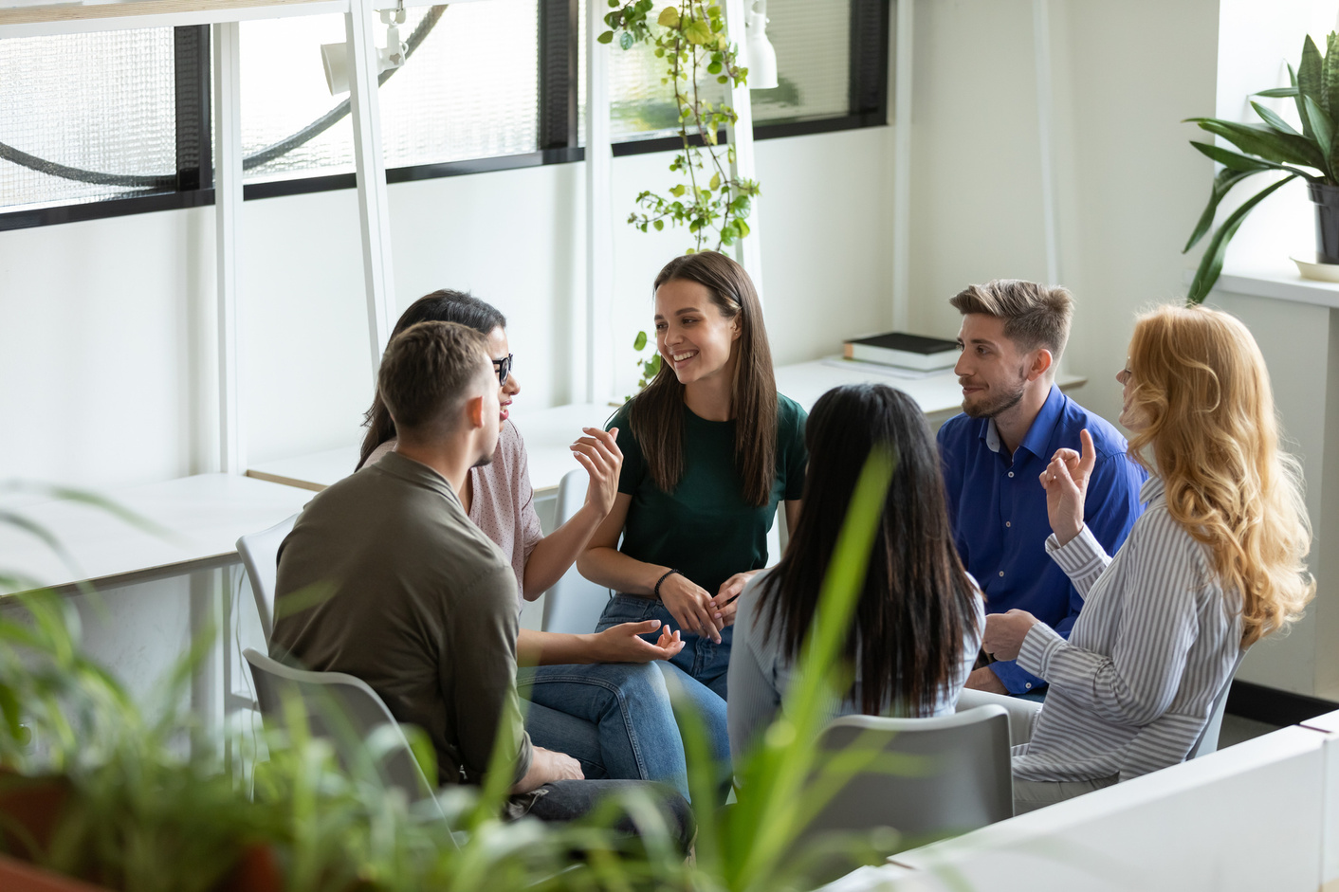


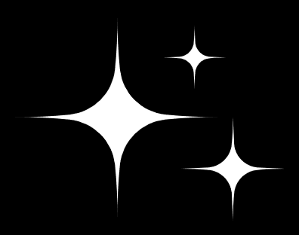


Declaring contest winner
In the contest, the user with the most likes on a single picture won
Details-
User Id
Username
Image_url
Likes
52
Zack_Kemmer93
https://jarret.name
48

Slide 10


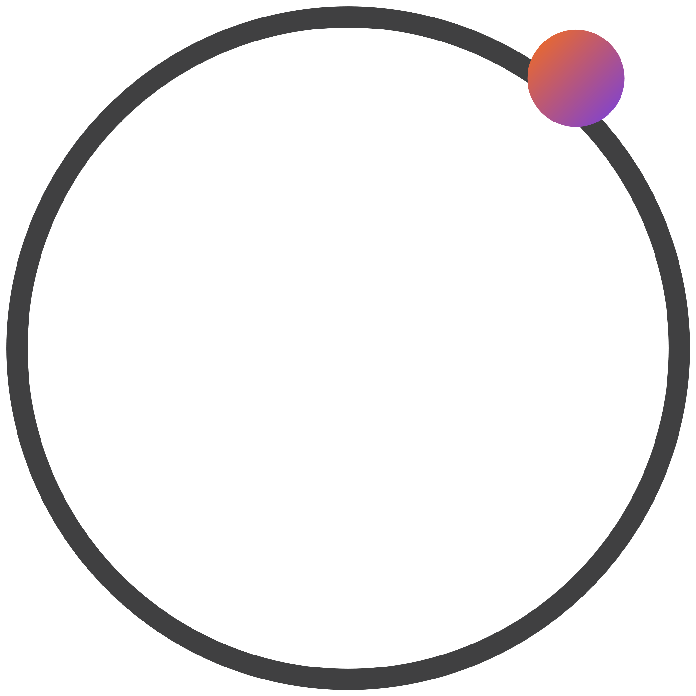

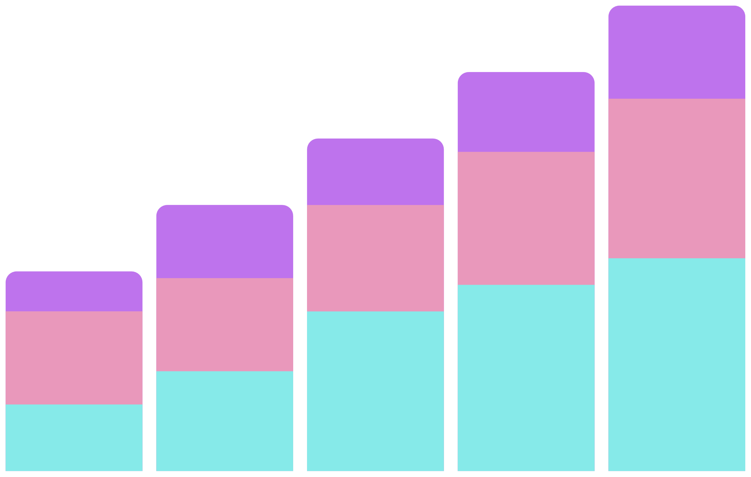

# Hashtag Researching
MARKETING DEPARTMENT
Top 5 hashtags that are most frequently used on Instagram
#Smile
#Beach
#Party
#Fun
59
42
#Concert
39
38
24

Slide 11


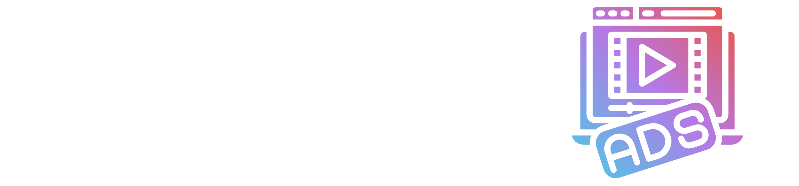


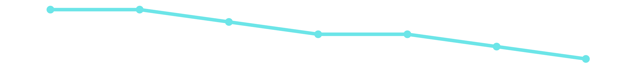
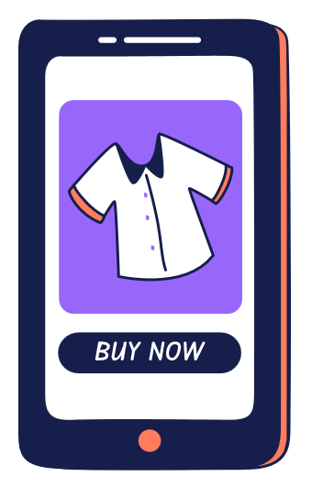
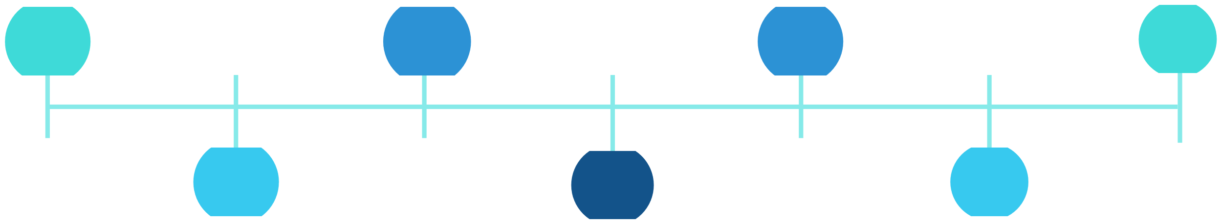
Launch AD campaign
Registrants are most active on this day of the week
20 15 10 5 0
Thursday
Sunday
|
|
|
|
|
|
|
|
|
|
|
|
|
|
|
|
|
|
|
|
|
|
|
|
|
|
|
|
|
|
16
16
|
|
|
|
|
The best time to schedule an advertisement campaign is on Thursday and Sunday
Thursday
Sunday
Friday
Monday
Tuesday
Wednesday
Saturday
16
Sunday
15
Tuesday
14
Wednesday
12
Thursday
Friday
Monday
Saturday
16
14
13

Slide 12



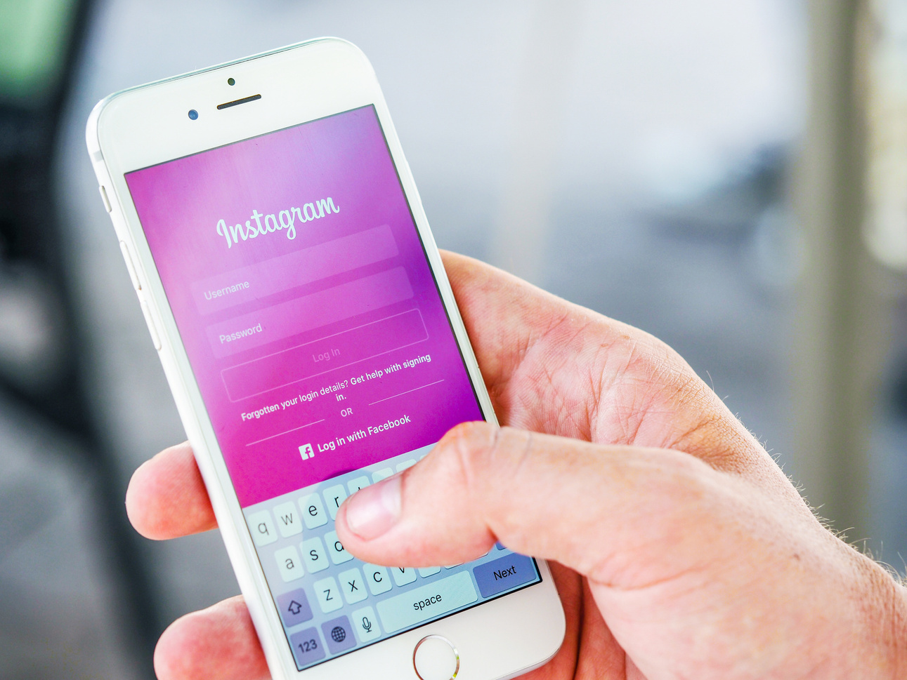
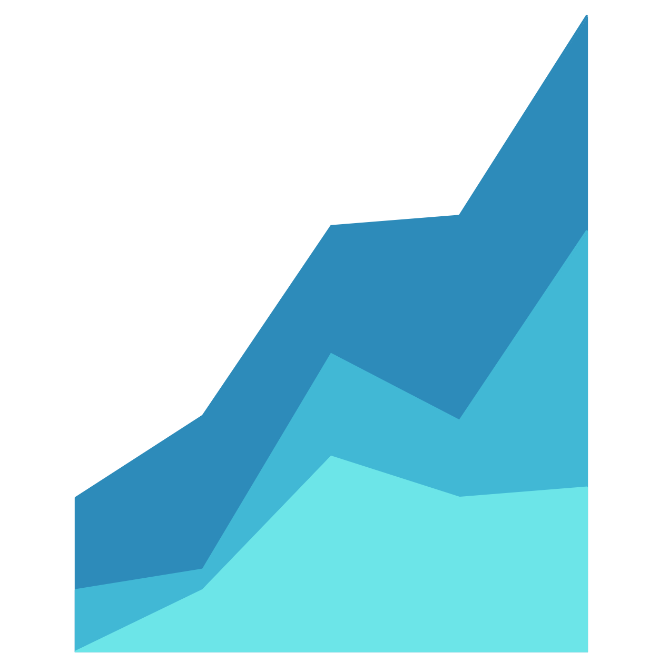

User Engagement
Based on the results, there are -
74 Active users who have posted at least once.
100 Total users (as per the data)
257 Total posts made.
Total Photos/Total users = 257/100 = 2.57
so the average will be 257/74 = 3.47
Based on the data we can say that an average user posts 3-4 times.
74%
257/74 = 3.47

Slide 13
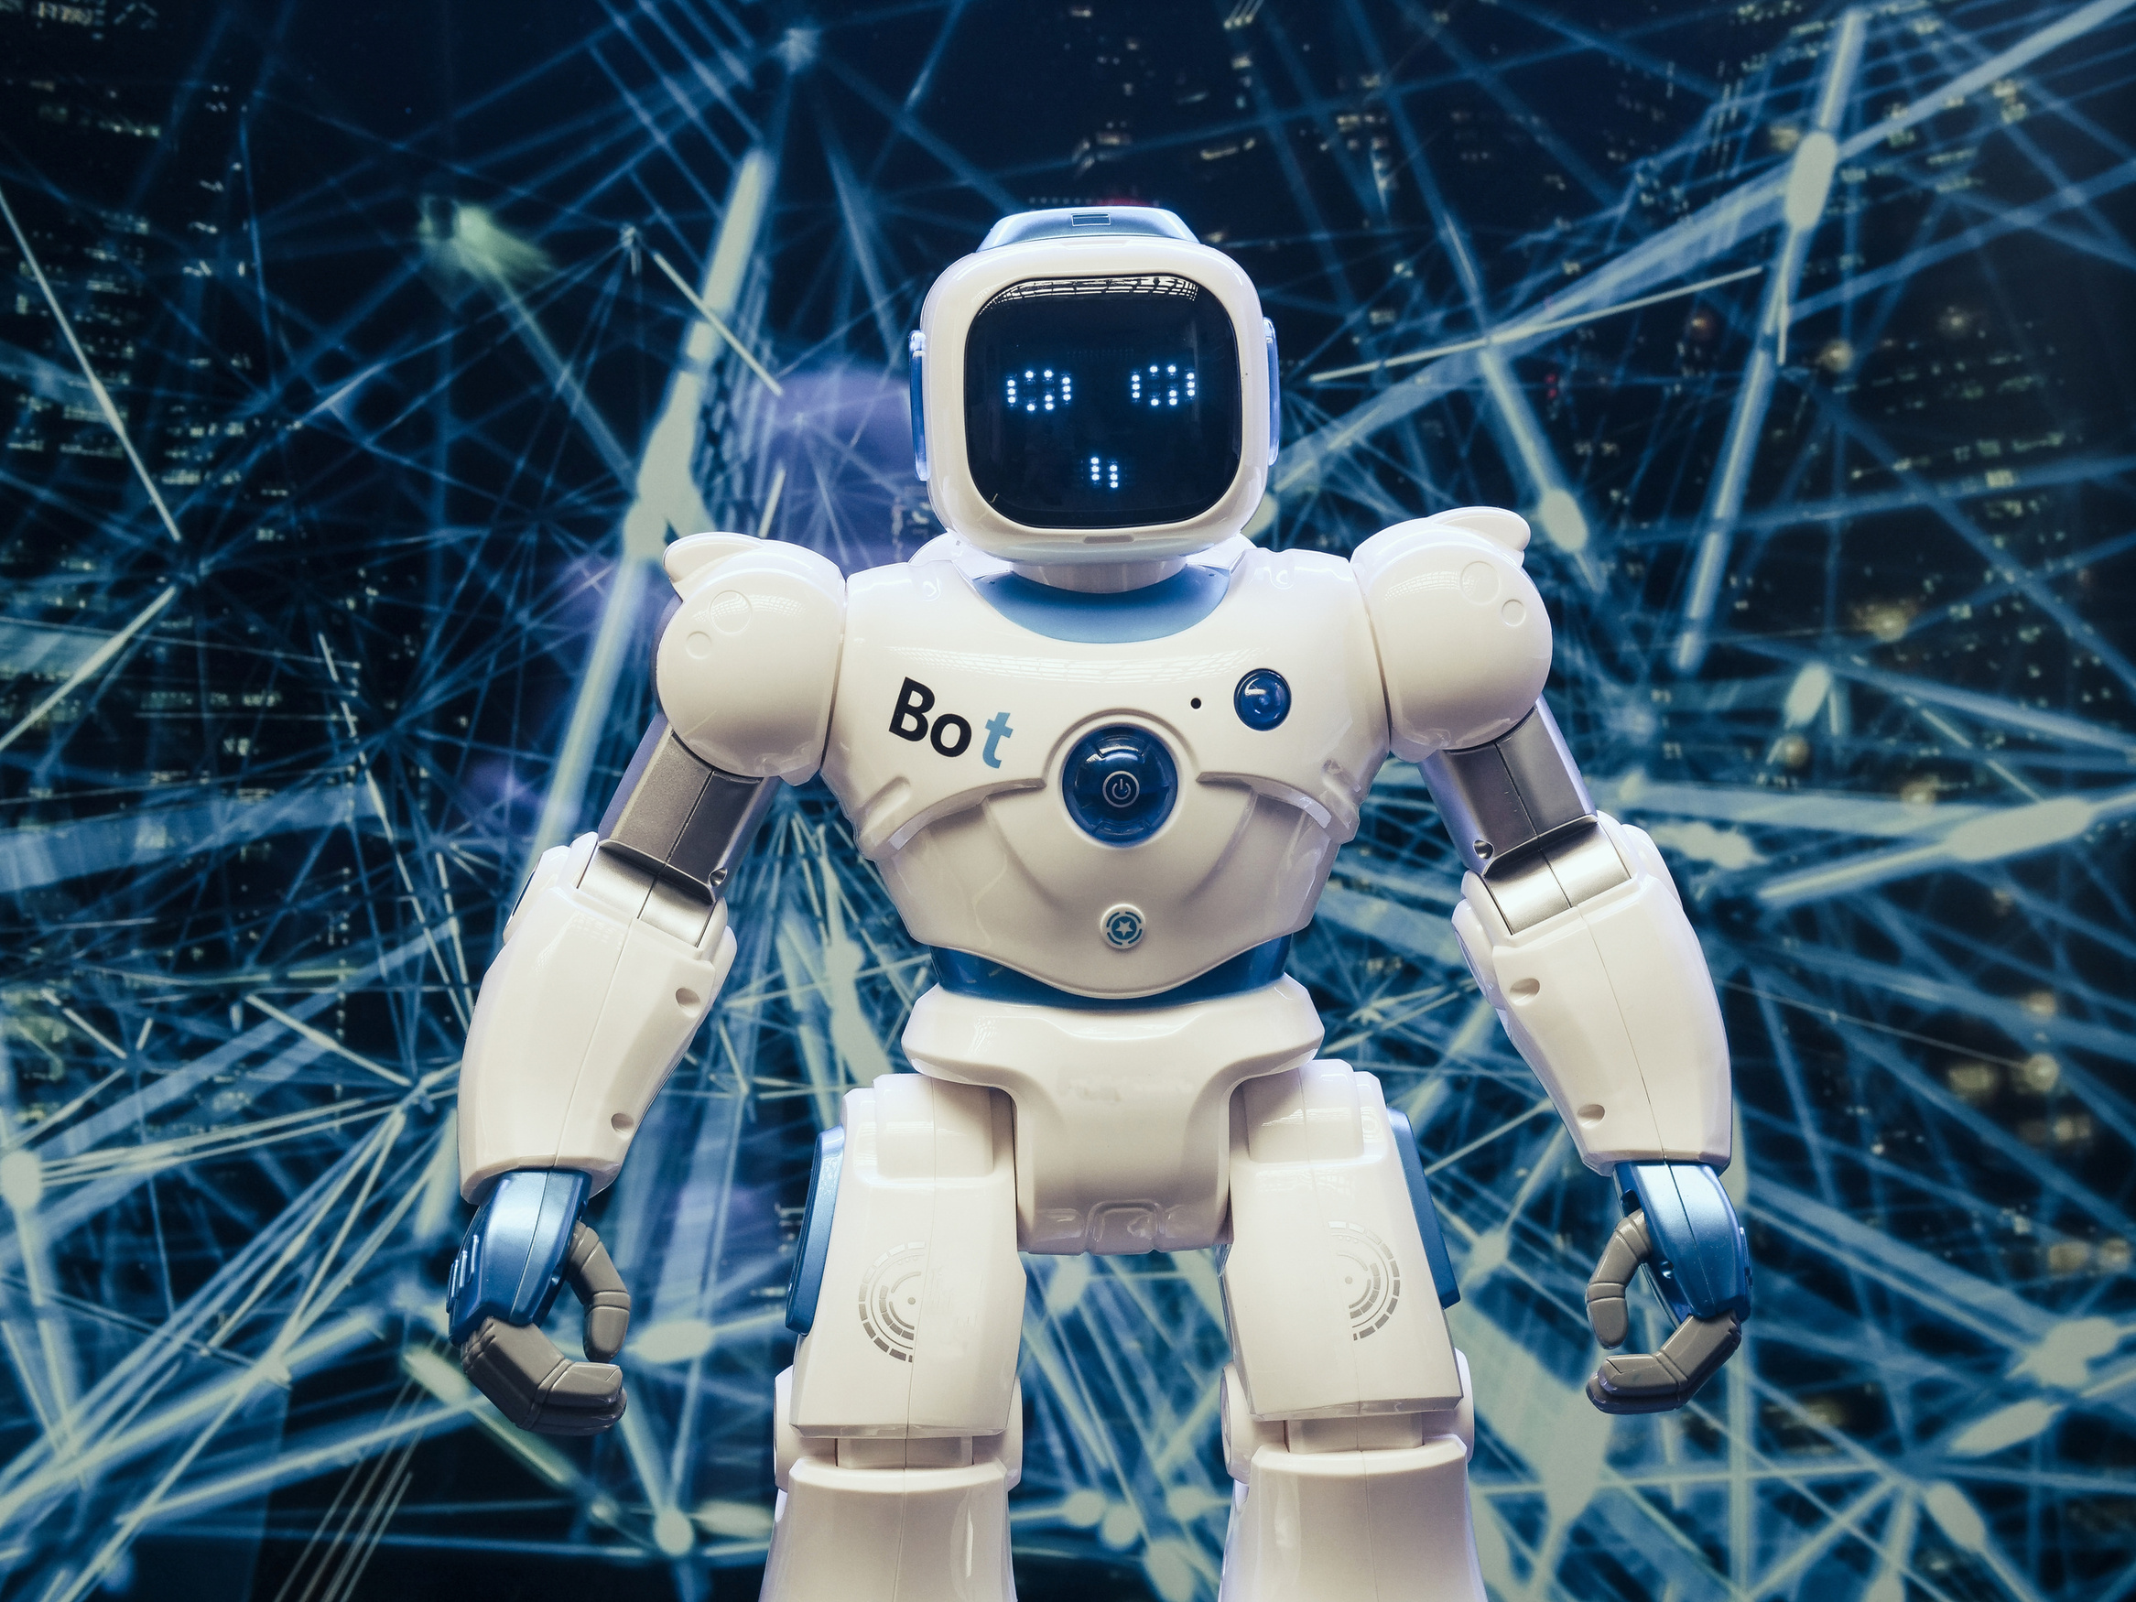









Bots & Fake Accounts
The users who have liked every single photo on the site will be considered as bots
We have 13 such users based on the data who have liked all 257 posts, user-Id for the same are specified below.
5 14 21 24
36 41 54 57
66 71 75 76
91
Investor Metrics

Slide 14

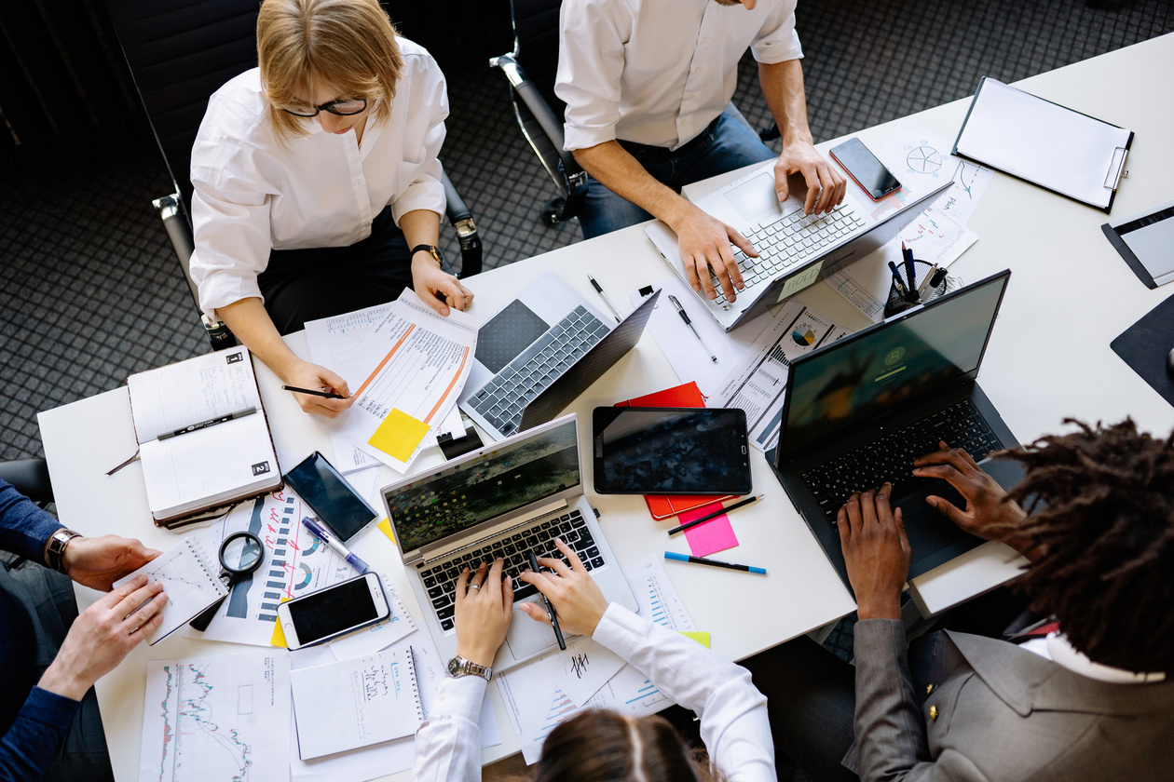
APPROACH
For this project, I have used My SQL to extract the required data from the given database using the Join function, subqueries, Aggregation, where condition, Group by, Distinct and other functions required.
Keeping the Primary key and foreign key in
consideration provided all the reports asked by
the marketing department and Investor
metrics department.
I have used canva for making this presentation
as it contains required Elements, Graphs,
Images which made this project more
attractive.

Slide 15
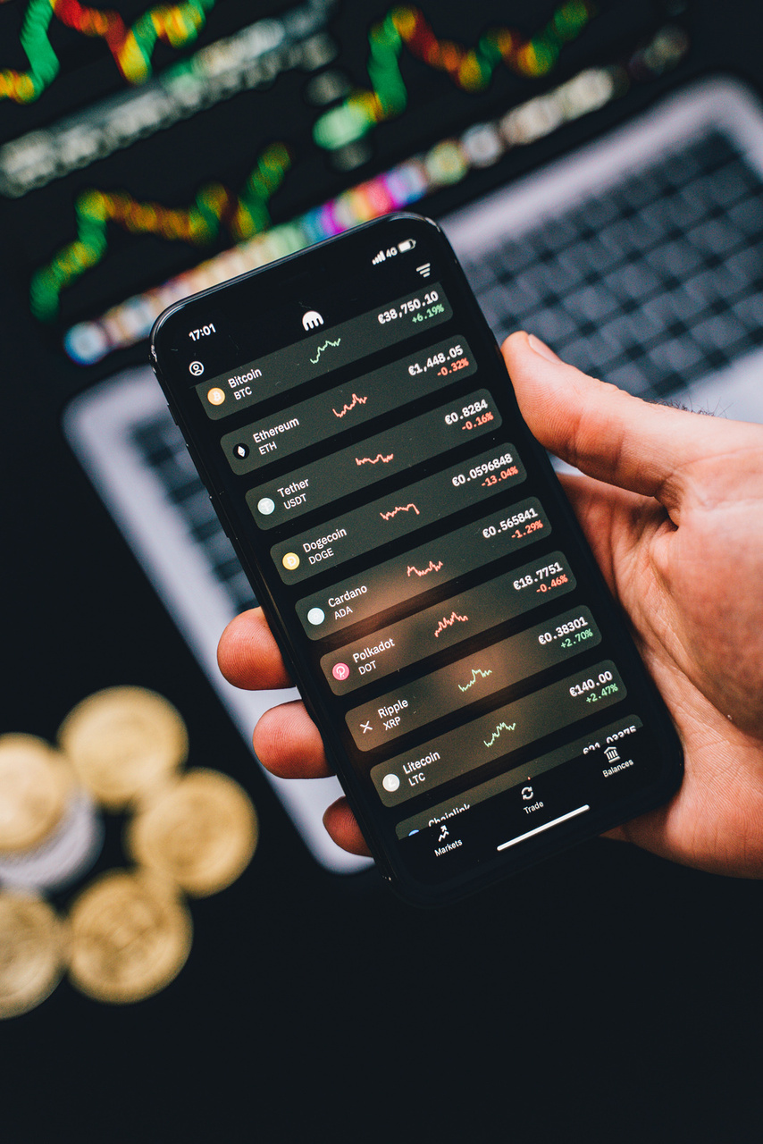
Insights and Results
From this project, I got an idea about how as a business or data analyst we work on real-time data to take any data-driven decision.
One thing I infer about this project is the dataset provided was very limited and small in respect of Rows and columns, But still, it was a very good experience working on such kind of project.
It helped me a lot to understand the analysis process well, and to provide insights for the best decision possible

